Slide 1
Unit 6 Parallel Circuits
Part A: Identifying a Parallel Circuit

Slide 2
What will you learn?
What a parallel circuit connection is.
Applications of parallel connections.

Slide 3
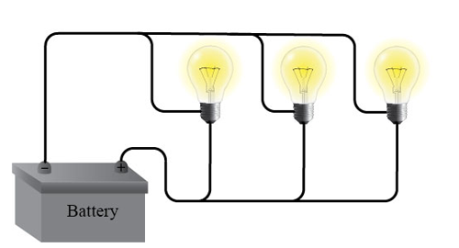
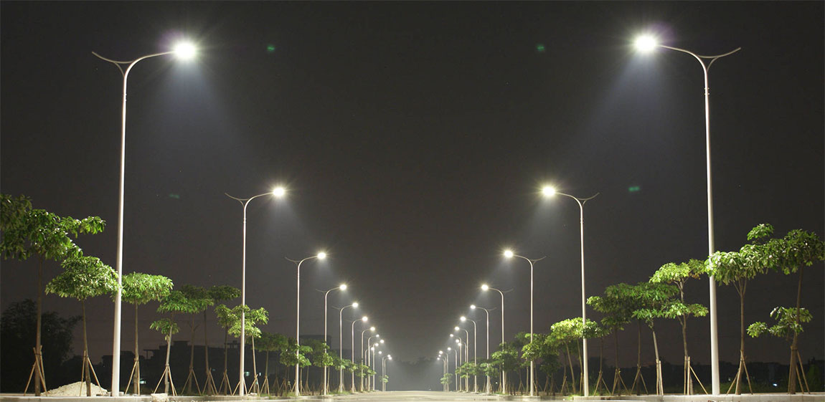


Identifying a parallel connection
It is not hard to spot a lamppost.
When you see one, you will get to see more…
It is easier to recognize them when their lights are turned on.
When one light starts to flicker, the others glow as usual.
You may realize that the lighting wirings and the AC power sockets are connected in parallel.

Slide 4
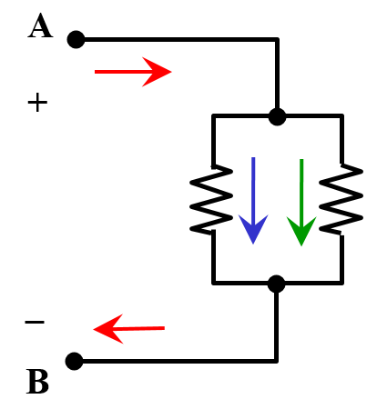
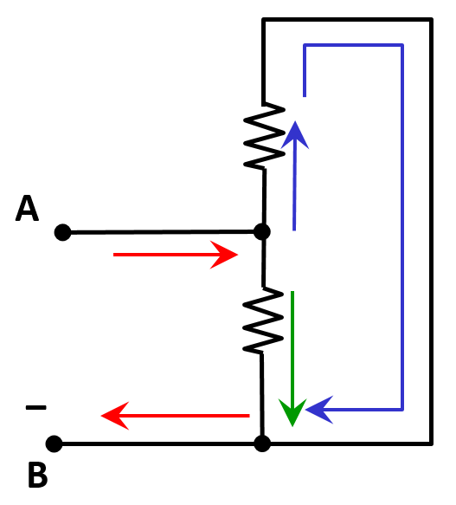
Identifying a parallel connection
When you come to identify a parallel connection of components in a schematic diagram, you look out for this feature:
2 or more components are connected across the same pair of nodes.
Therefore, when components are connected in parallel, the voltage across each component is the same.
R₁
R₂
R₁
R₂

Slide 5

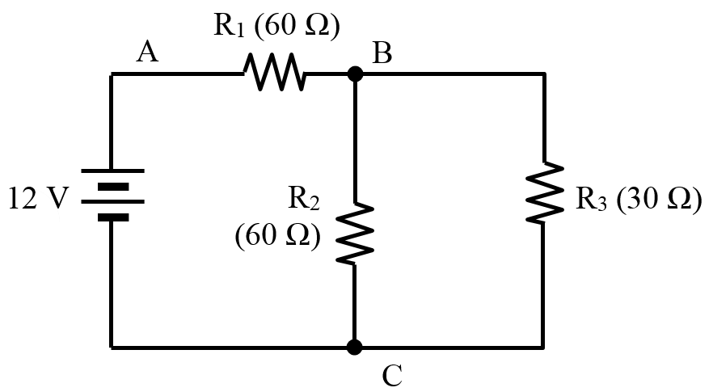
Example 1: Identify a parallel connection in the schematic diagram.
There are two resistors, R₂ and R₃, sharing the two common nodes, B and C.

Slide 6
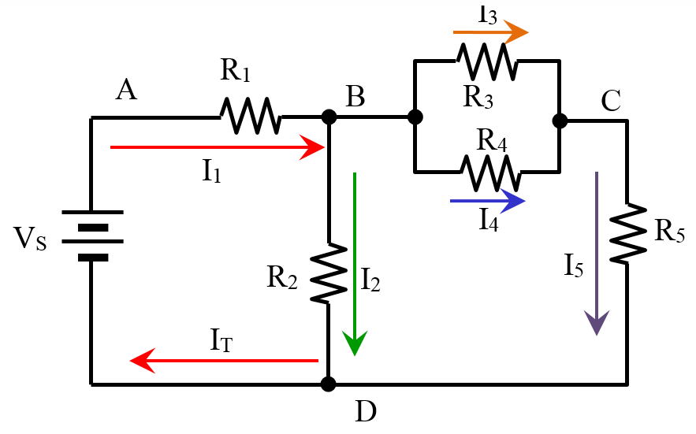

Example 2: Identify the parallel connection in the schematic diagram.
There is one. R₃ and R₄ are both connected across nodes B and C.
R₃ and R₄ are connected in parallel across B and C.

Slide 7
You have learned
A parallel connection has two or more components connected across two common nodes, hence,
the same voltage is applied across each component.
Lightings and AC power sockets are wired in parallel connections.

Slide 8
Coming Up Next
Kirchhoff’s Current Law and Current Divider Rule

